Slide 1
GU LIVE SAFE (MOBILE APPLICATION TO ACCESS THE SECURITY SERVICE PROVIDED BY GANNON POLICE)
DINESHARUMUGAM SENTHIL ARUMUGAM
PRASHANTH KUMAR LANKADHASARI
Plan – B Technical Project
To be presented on 04/29/2016
STAKEHOLDER: LESTER L. FETTERMAN
ADVISOR: Dr. STEPHEN T. FREZZA

Slide 2
INTRODUCTION
Purpose of this project is to develop a mobile application to access the security service provided by Gannon police.
The Gannon police provide certain services to give safety to students, faculties and staffs.
The primary purpose of the project is to develop an application that provides easy access to the Gannon Security services and in turn provides Gannon Police to serve students efficiently.

Slide 3
PROBLEM STATEMENT
ELEMENT | DESCRIPTION
The problem of … | People getting into trouble while walking in and around campus arena.
Affects … | Assault, harassment, sexual assault etc. …
And results in … | Getting serious injuries, loss of life, etc. …
Benefits of a solution … | Keeps yourself safe by using this application.

Slide 4
BACKGROUND
Gannon has an escort service called GUEST where users can request an escort in person, by a phone call to Police and Safety, or, newly, by texting a number.
The GUEST service is vastly under-utilized by the campus community.
Students have a perception of low safety, but still do not use the service.

Slide 5
PROJECT OBJECTIVES
Build GU LiveSafe mobile multi-platform app that:
Increase Campus utilization of escort service.
Increase Students, Faculty and Staff perception of safety by survey metrics.
Increase ease of management for switchboard operator.
Make use of mapping system for virtual escorting feature.

Slide 6
Technical Approach
Project Initialization – gather requirements.
App should be capable to be deployed through PhoneGap.
Small incremental release phases are planned and iterated.

Slide 7
Requirements
Context diagram and usecase diagram: To identify objects outside the system that connect to it.
Storyboards and low-fidelity prototypes: To flesh out the dialog map by showing what each screen will contain without depicting precise details.
Flowcharts and Activity diagrams: To visually depict the flow of the use case dialog and branches into alternative flows and exceptions
Class diagrams: To show the logical connections between object classes and the data associated with them.

Slide 8

Architecture Design
GOOGLE MAP API
APPLICATION
GPS LOCATION
LOGIN INFO
REQURST MESSAGES
INFORMATION REPORTING
DATA BASE
SWITCHBOARD
SECURITY SERVICES
WEB SERVER

Slide 9
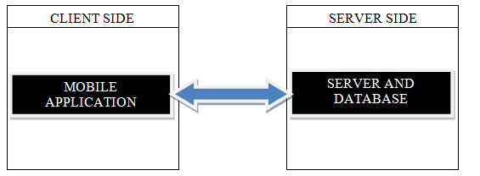
IMPLEMENTATION DESIGN
Overall Implementation:

Slide 10
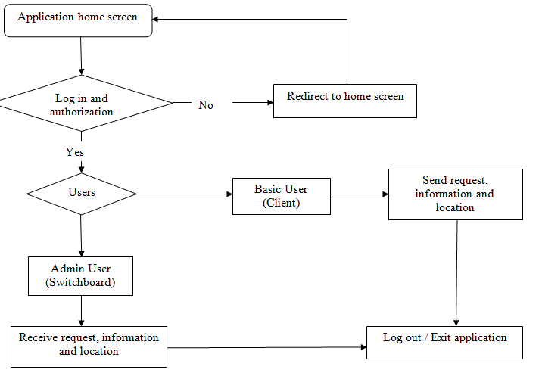
Mobile Application

Slide 11

Server and Database

Slide 12
Quality Assurance Plan
A constant track of code in maintained and tested to make sure the code is working properly.
Usability testing is used to check the ease of application prototype.
Testing done to make sure the database is secured.

Slide 13
Expected Project Results
Student being able to download the app.
Student is able to access (login) the app.
Student being able to request an escort.
Student is able to cancel or reschedule an escort request.
Switchboard is able to receive an escort request anytime.
Switchboard is able to access and view any request for an escort.
Students being able to request for shuttle service.
Students being able to request for virtual watch.
Switchboard is able to escort virtually.
Student being able to report crime/emergencies.
Switchboard is able to receive the crime/emergencies report.
The database is delivered.
Server able to test, run and debug any problem.
Data stored is secured and protected.

Slide 14
Measures Of Success
30% increase in utilization of security service occurs within 3 months of deployment.
25% - 40% reduce in rate of Gannon students, staffs and faculties facing problems while walking or travelling in and around campus.

Slide 15
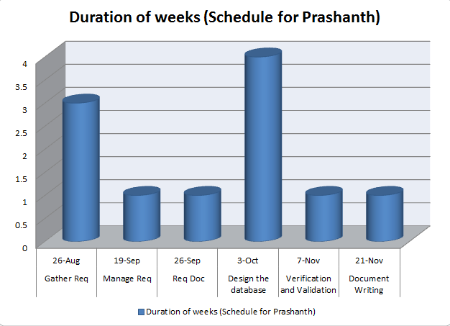
Schedule

Slide 16
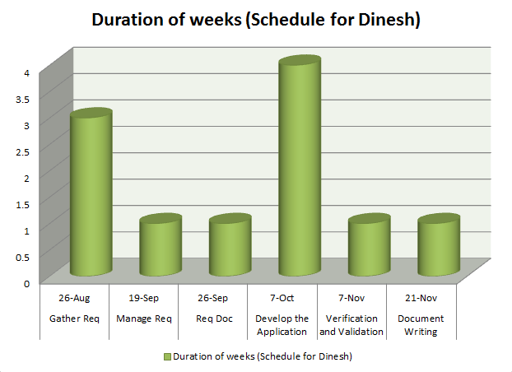

Slide 17

THANK YOU !! Any Queries…???

